Slide 1
Chapter-15
General Purpose Programmable Peripheral Devices
15.1 THE 8255A PROGRAMMABLE PERIHERAL INTERFACE
The 8255A is a widely used, programmable, parallel I/O device. It can be programmed to transfer data under various conditions, from simple I/O to interrupt I/O. It is flexible, versatile, and economical (when multiple I/O ports are required), but somewhat complex. It is an important general-purpose I/O device that can be used with almost any microprocessor.
The 8255A has 24 I/O pins that can be grouped primarily in two 8-bit parallel ports: A and B, with the remaining 8-bits as port C. The eight bits of port C can be used as individual bits or grouped in two 4-bit ports: C_{UPPER} (C_{U}) and C_{LOWER} (C_{L}), as in Figure 15.1(a). The functions of these ports are defined by writing control word in the control register.

Slide 2
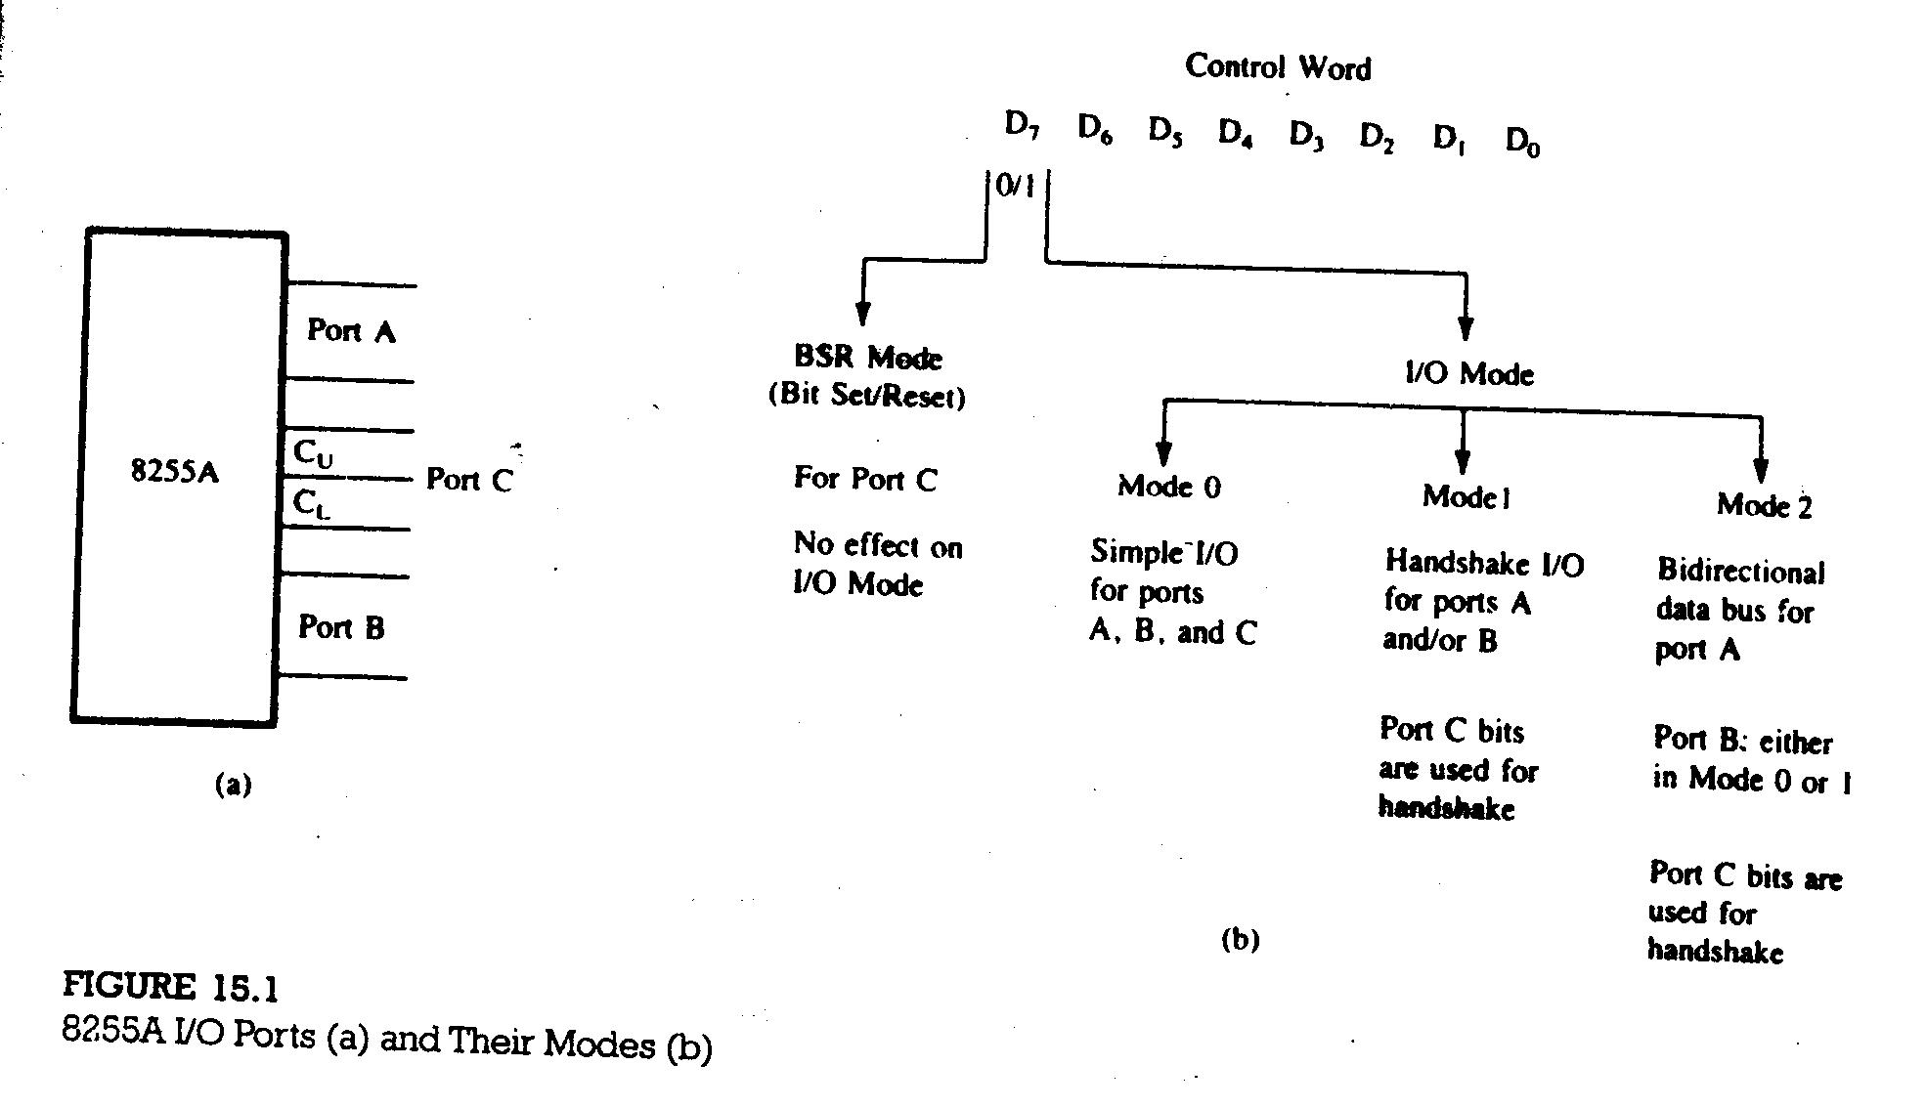

Slide 3
Figure 15.1(b) shows all the functions of the 8255A, classified according to two modes: the Bit Set/Reset (BSR) mode and the I/O mode. The BSR mode is used to set or reset the bits in port C. The I/O mode is further divided into three modes: Mode 0, Mode 1, and Mode 2.
Mode 0: all ports function as simple I/O ports.
Mode 1: handshake mode; ports A and/or B use bits from port C as
handshake signals.
Mode 2: port A for bidirectional data transfer using handshake signals from
port C, and port B can be either Mode 0 or Mode 1.
15.1.1 Block Diagram of the 8255A
The block diagram in Figure 15.2(a) shows two 8-bit ports (A and B), two 4-bit ports (C_{U} and C_{L}).

Slide 4
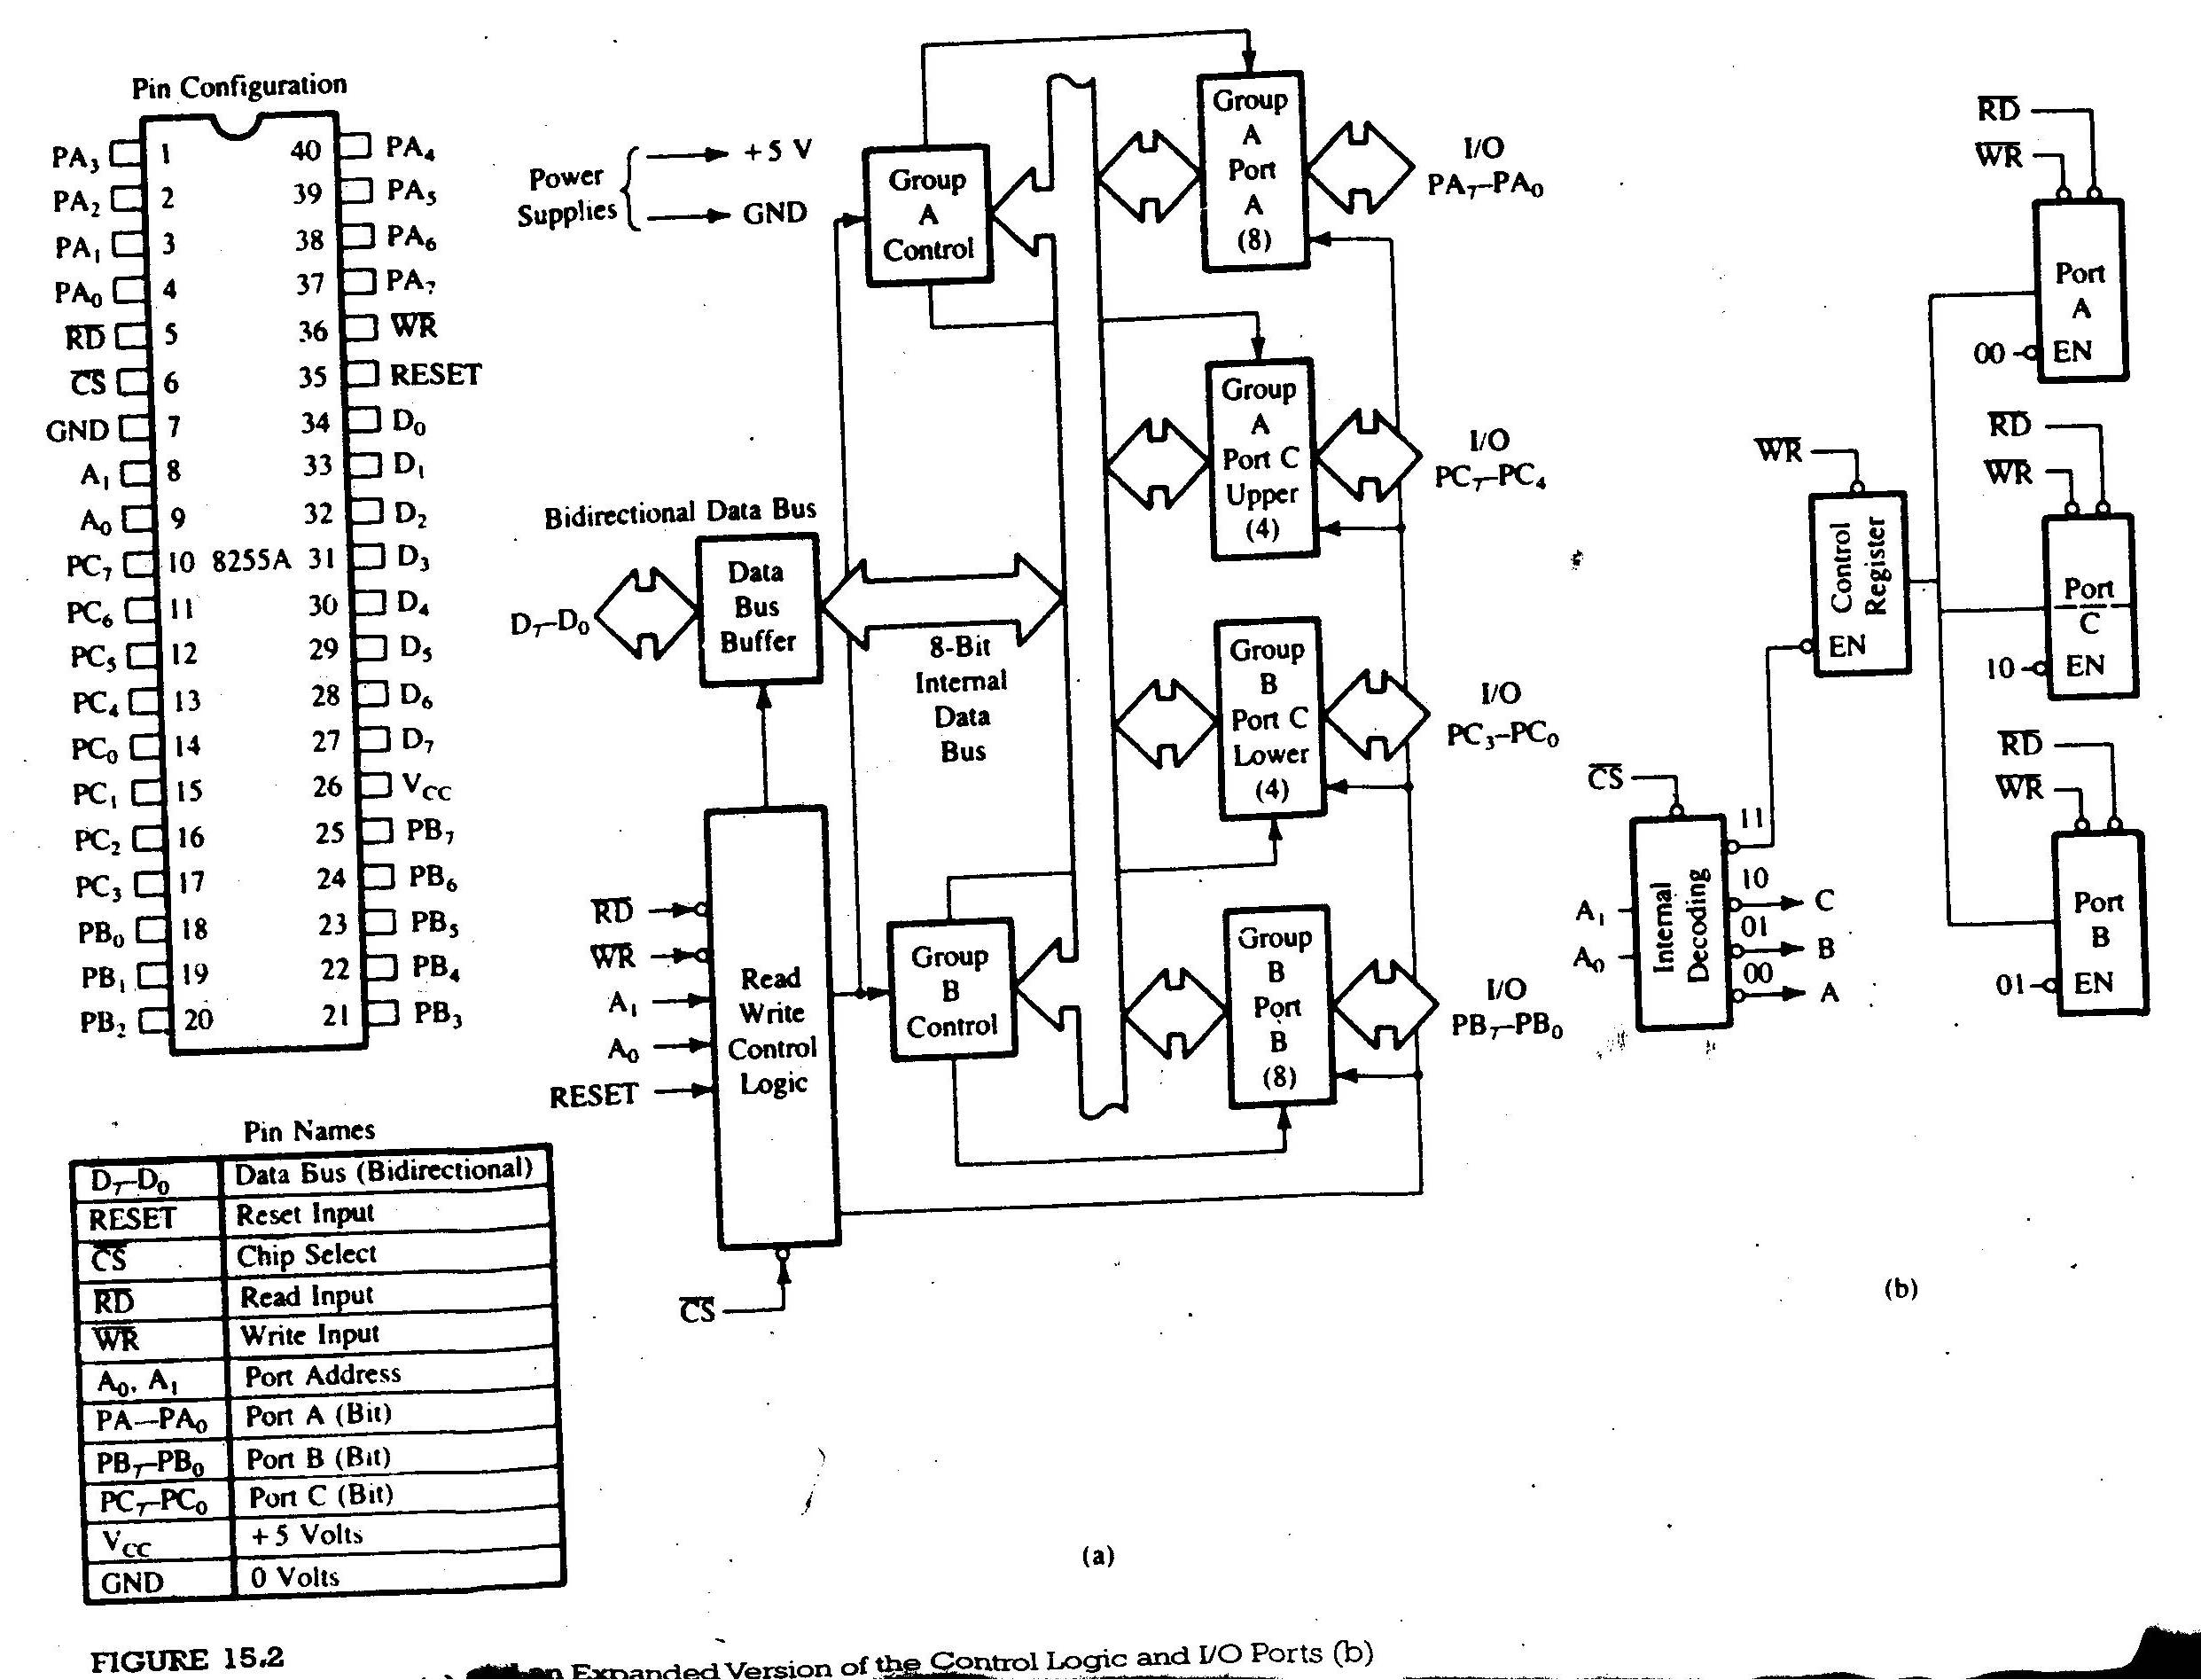

Slide 5
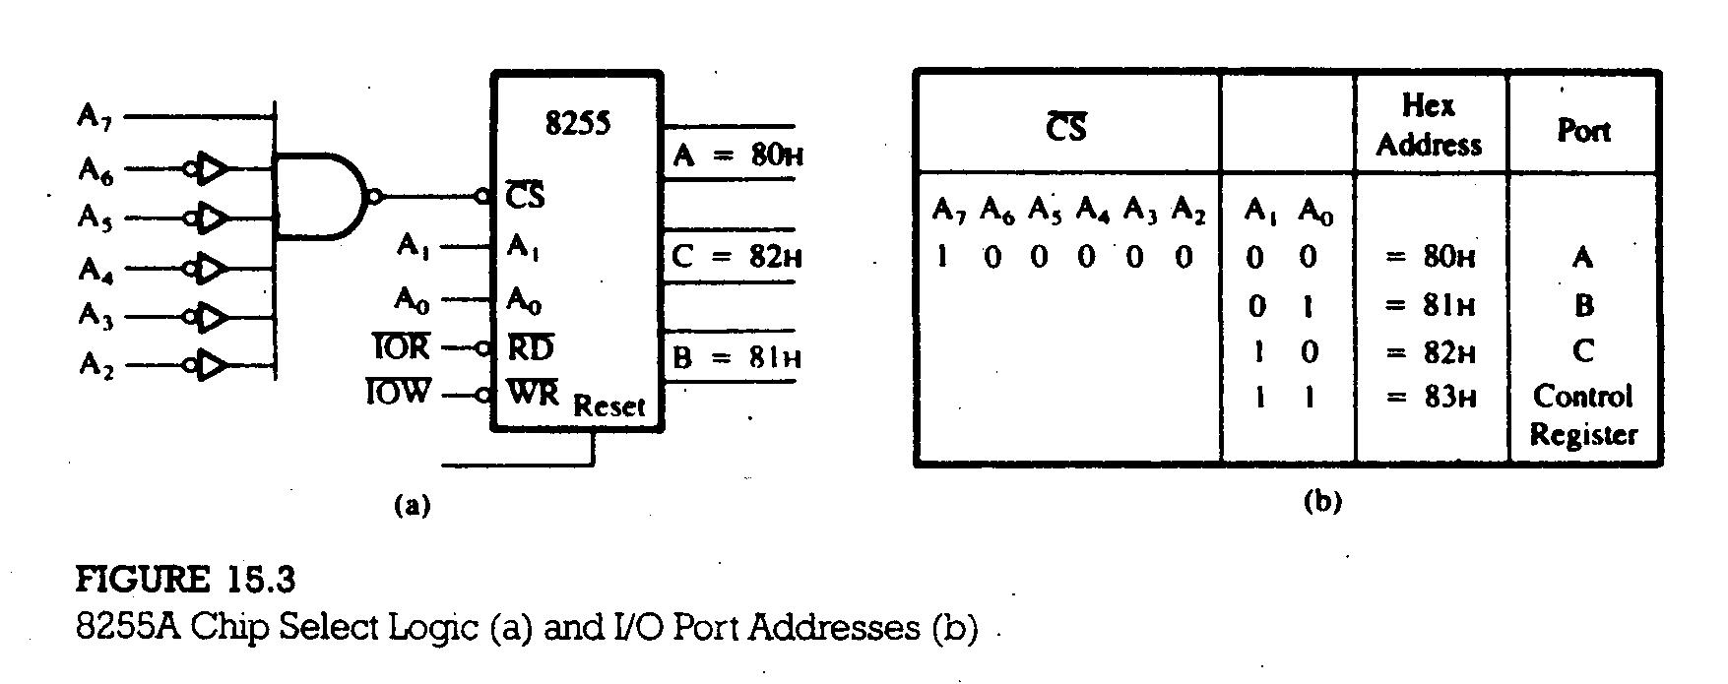

Slide 6
CONTROL WORD
The bit D₇ specifies either the I/O function or the Bit Set/Reset function as classified in Figure 15.1(b). Figure 15.4 shows the control word format for I/O Mode.
To communicate with the peripherals through the 8255A, three step are necessary through the 8255A, three steps are necessary:
Determine the addresses of ports A, B, and C and of the control register according to the Chip Select logic and A₀ and A₁.
Write a control word in the control register.
Write I/O instructions to communicate through ports A, B, and C.
15.1.2 Mode 0: Simple Input or Output
In this mode, ports A and B are used as two simple 8-bit I/O ports and port C as two 4-bit ports. Each port (or half-port, in case of C) can be programmed to function as simply an input port or an output port. The input/output features in Mode 0 are as follows:

Slide 7
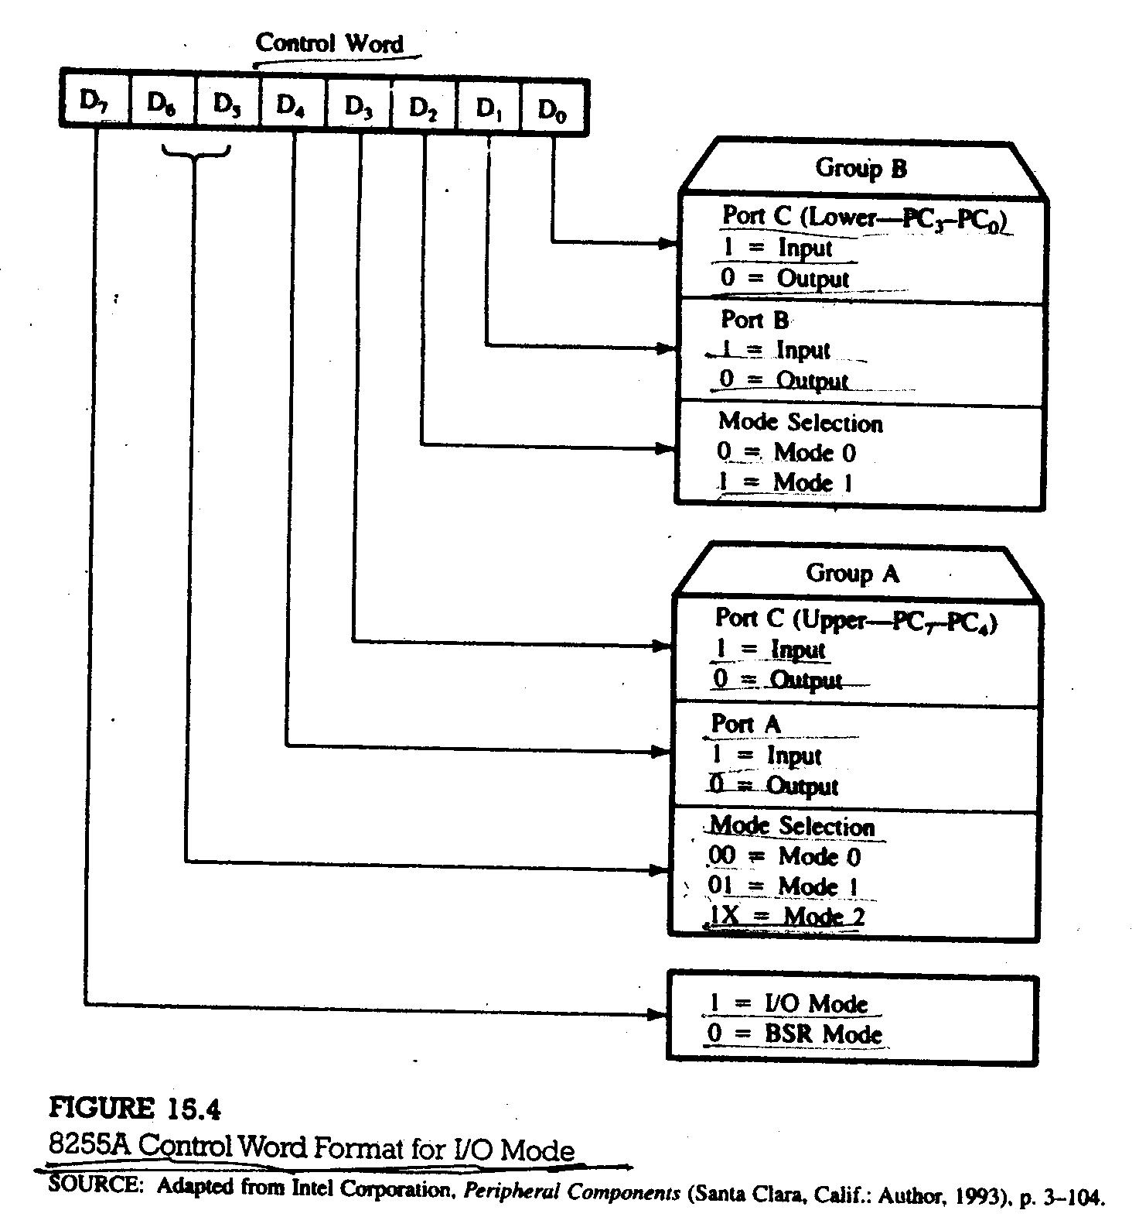

Slide 8
Outputs are latched.
Inputs are not latched.
Ports do not have handshake or interrupt capability.
Example 15.1:
1. Identify the port addresses in Figure 15.5.
2. Identify the Mode 0 control word to configure port A and port C_{U} as output
ports and port B and port C_{L} as input ports.
3. Write a program to read the DIP switches and display the reading from
port B port A and from port C_{L} at port C_{U}.
Solution:
Port Addresses
Port A = 8000H (A₁=0, A₀=0)
Port B = 8001H (A₁=0, A₀=1)
Port C = 8002H (A₁=1, A₀=0)
Control Register = 8003H (A₁=1, A₀=1)

Slide 9
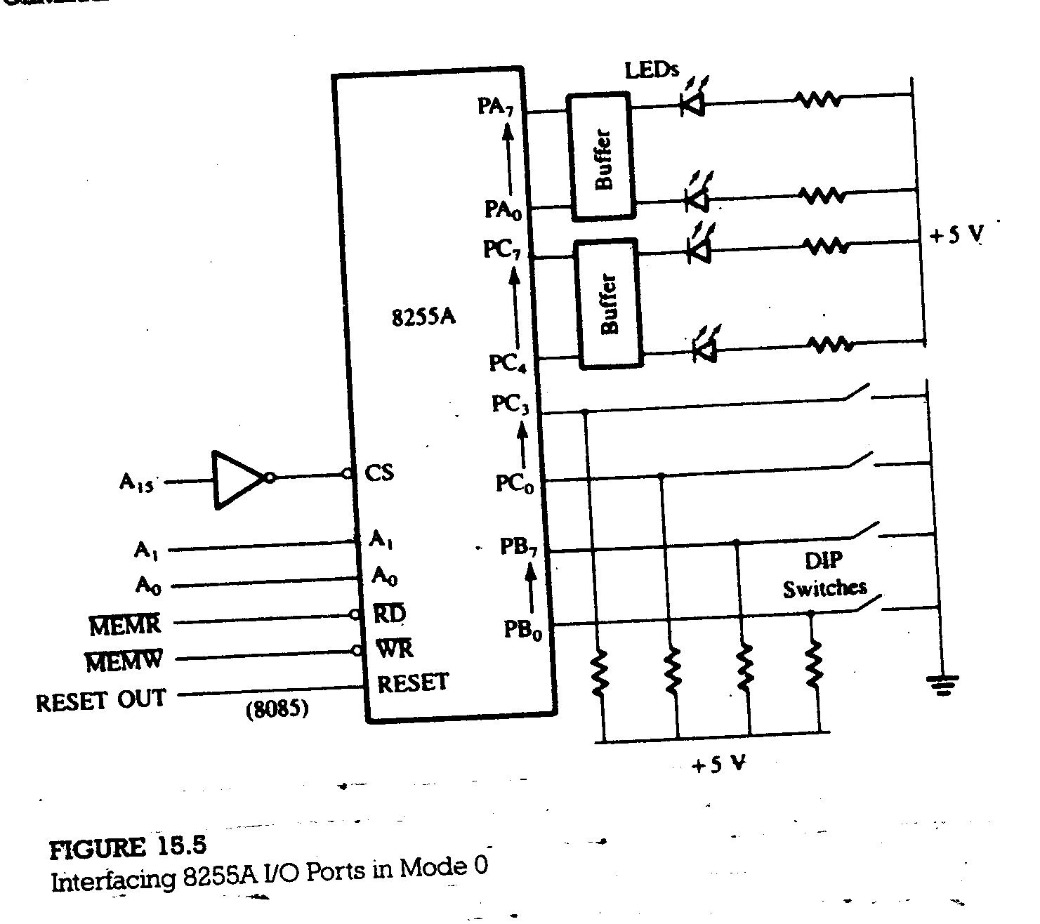

Slide 10
2. Control Word
D₇ D₆ D₅ D₄ D₃ D₂ D₁ D₀
1 0 0 0 0 0 1 1 = 83H
Program
    MVI A,83H
    STA 8003H
    LDA 8001H
    STA 8000H
    LDA 8002H
    ANI 0FH
    RLC
    RLC
    RLC
    RLC
    STA 8002H
    HLT

Slide 11
15.1.3 BSR (Bit Set/Reset) Mode
The BSR mode is concerned only with the eight bits of port C, which can be set or reset by writing an appropriate control word in the control register. A control word with bit D₇=0 is recognize as a BSR control word, and it does not alter any previously transmitted control word with bit D₇=1; thus the I/O operations of ports A and B are not affected by a BSR control word. In the BSR mode, individual bits of port C can be used for applications such as an on/off switch.
BSR CONTROL WORD
This control word, when written in the control register, sets or resets one bit at a time, as specified in Figure 15.6.
Example 15.2 :
Write BSR control word subroutine to set bits PC₇ and PC₃ and reset them after 10 ms. Use the schematic in Figure 15.3 and assume that a delay subroutine is available.

Slide 12
Figure 15.6 : 8255A Control Word Format in the BSR Mode
D₇ D₆ D₅ D₄ D₃ D₂ D₁ D₀
0
X
X
X
Bit Select
S/R
Set = 1
Reset = 0
BSR Mode
Not Used,
Generally Set = 0
000 = Bit 0
001 = Bit 1
010 = Bit 2
011 = Bit 3
100 = Bit 4
101 = Bit 5
110 = Bit 6
111 = Bit 7

Slide 13
BSR Control Words
D₇ D₆ D₅ D₄ D₃ D₂ D₁ D₀
To set bit PC₇ = 0 0 0 0 1 1 1 1 = 0FH
To reset bit PC₇ = 0 0 0 0 1 1 1 0 = 0EH
To set bit PC₃ = 0 0 0 0 0 1 1 1 = 07H
To reset bit PC₃ = 0 0 0 0 0 1 1 0 = 06H
PORT ADDRESS
Control register address = 83H; refer to Figure 15.3(b).
SUBROUTINE
BSR: MVI A, 0FH
    OUT 83H
    MVI A,07H
    OUT 83H
    CALL DELAY
    MVI A,06H
    OUT 83H
    MVI A,0EH
    OUT 83H
    RET

Slide 14
15.4 THE 8254 (8253) PROGRAMMABLE INTERVAL TIMER
The 8254 programmable interval timer/counter is functionally similar to the software designed counters and timers described in chapter 8. It generates accurate time delay and can be used for applications such as a real-time clock, an event counter, a square-wave generator, and a complex waveform generator.
The 8254 includes three identical 16-bit counters that can operate independently in any one of the six modes. It is packaged in a 24-pin DIP and requires a single +5v power supply. To operate a counter, a 16-bit count is loaded in its register and, on command, begins to decrement the count until it reaches 0. At the end of the count, it generates a pulse that can be used to interrupt the MPU. The counter can count in binary or BCD. In addition, count can be read by the MPU while counter is decrementing.
15.4.1 Block Diagram of the 8254
Figure 15.23 is the block diagram of the 8254; it includes three counters (0, 1, 1 and 2), a data bus buffer, Read/Write control logic, and a control register. Each counter has two input signals-Clock (CLK) and GATE-and output signal-OUT.

Slide 15
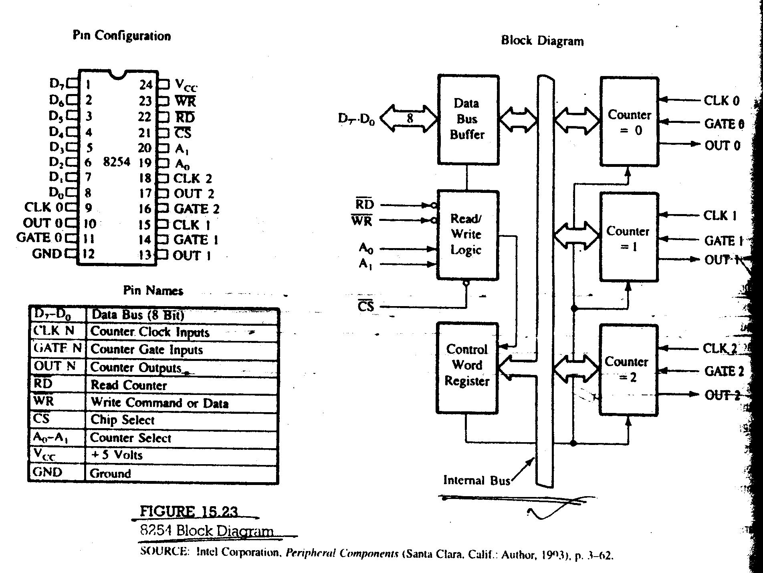

Slide 16
CONTROL LOGIC
A₀ A₁ Selection
0 0 Counter 0
0 1 Counter 1
1 0 Counter 2
1 1 Control Register
CONTROL WORD REGISTER
The control word format is shown in Figure 15.24.
MODE

Slide 17
